Slide 1
Work, energy and power
MS864M

Slide 2
An alternative approach to mechanics
Many problems in mechanics involve forces which are not constant.
Solving this type of problems using Newton’s laws can be very difficult.
An alternate method based on the concepts of Work, Energy and Power can greatly simplify calculations.

Slide 3
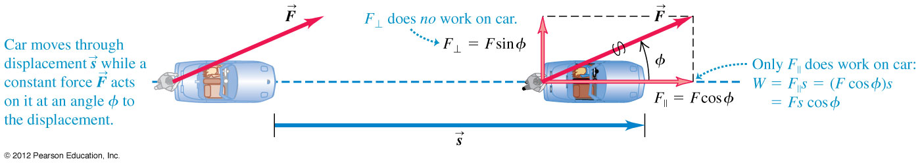
Work done by a constant force
The work done by a constant force is defined as where φ is the angle between the force and the displacement.

Slide 4
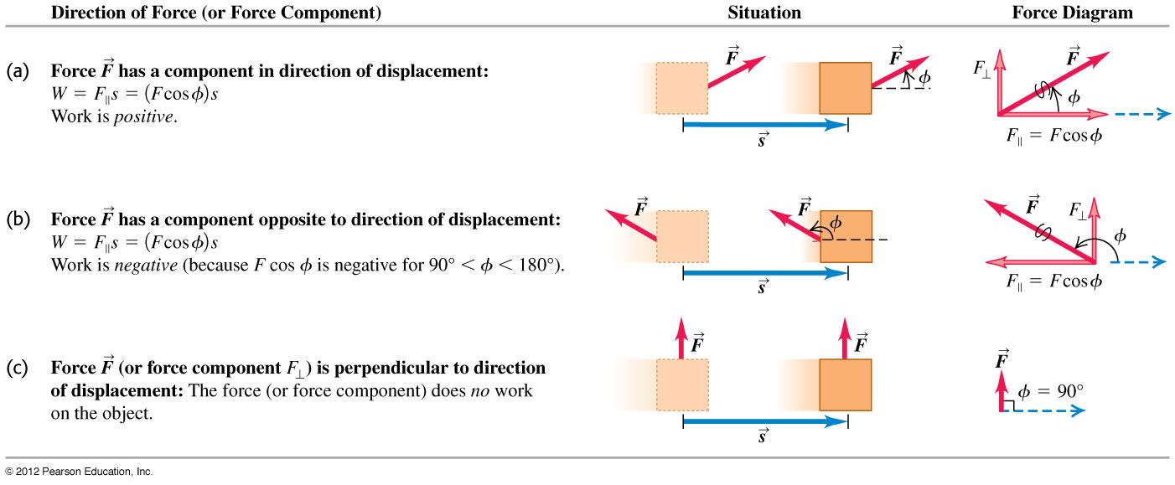
Work done by a constant force
A force can do positive work, negative work or zero work depending on the angle φ between the force and the displacement of the object.

Slide 5
Example 1
The diagram shows a force-displacement graph of an object. What is the work done for the whole journey?
F / N
10
s / m
5
10
-10

Slide 6
Example 2
a) Steve exerts a steady force of magnitude 210 N on a stalled car so that it moves a distance of 18 m. The car has a flat tire. So to make the car track straight Steve must push at an angle of 30º to the direction of motion. How much work does Steve do?
b) Steve pushes another stalled car with a steady force .. The displacement of the car is . How much work does Steve do?
Notes:
a) W = 3.3 × 10³ J b) W = 1.8 × 10³ J

Slide 7
Work due to many forces
If there are many forces acting on an object, to calculate the total work we can use one of the following two approaches:
i) Compute the work done by each separate force and add them up using algebraic addition.
ii) Compute the net force (vector sum) and find the work done by the net force.

Slide 8
Relationship between kinetic energy and work
A constant net force F_{x} acting on a mass m results in a displacement s along the +x-axis.
From kinematics,

Slide 9
Kinetic energy
The previous slide shows that the work done on the object has caused the object’s velocity to change.
The quantity ½ mv² is known as kinetic energy (KE or K).
Kinetic energy is a scalar quantity.
KE can never be negative. It is zero for an object at rest.
If v_{1x} = 0, then W_{total} = ½ mv_{2x}² = K₂ or simply W_{total} = ½ mv².
Note that the direction in which the object moved is not involved in the calculation of its KE.

Slide 10
Work-Energy theorem
The Work-Energy theorem states that the work done by the net force on an object equals the change in the kinetic energy of the object.
Therefore kinetic energy also has the SI unit of joule.
Since W_{total} = K₂ – K₁ = ∆K,
If W_{total} > 0, then KE increases (K₂ > K₁).
If W_{total} < 0, then KE decreases (K₂ < K₁).
If W_{total} = 0, then KE does not change (K₂ = K₁).
The work-energy theorem applies even when the forces are not constant and the particle’s trajectory is curved.

Slide 11
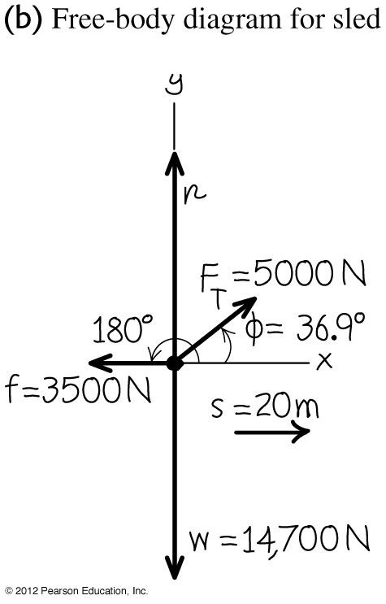
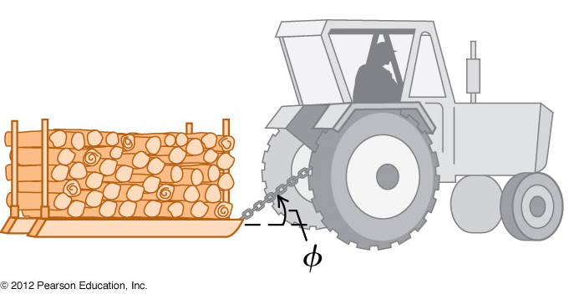
Work done by varying force Example 3
A farmer hitches his tractor to a sled loaded with firewood and pulls it a distance of 20 m along level ground (see figure). The total weight of the sled and load is 14700 N. The tractor exerts a constant force of 5000 N at an angle of 36.9º above the horizontal. A friction force of 3500 N opposes the sled’s motion. (a) Find the work done by each force acting on the sled and (b) the total work done by all the forces. (c) Suppose the sled’s initial speed is 2.0 m/s. What is the speed of the sled after it moves 20.0 m?
Notes:
a) W_{Tractor} = 80 × 10³ J, W_{friction} = -70 × 10³ J , W_{weight}= 0 J, W_{normal}= 0 J b) W_{total} = 10 × 10³ J c) v = 4.2 m/s

Slide 12
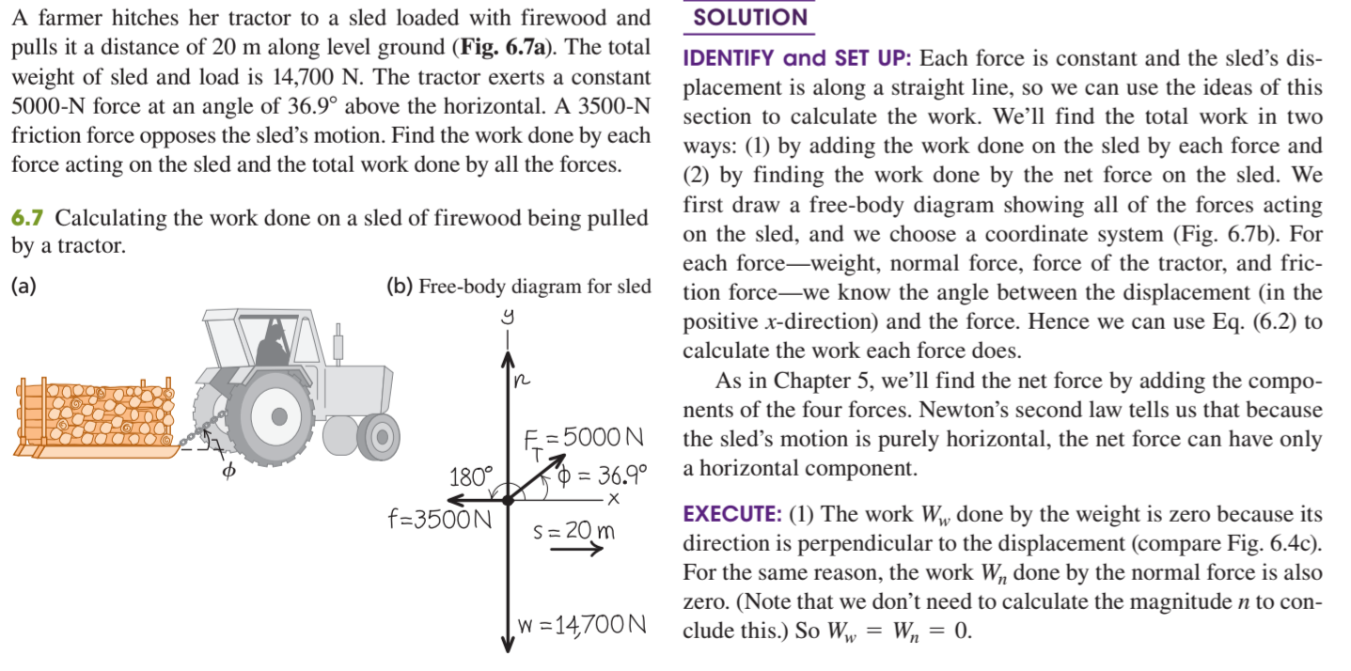

Slide 13
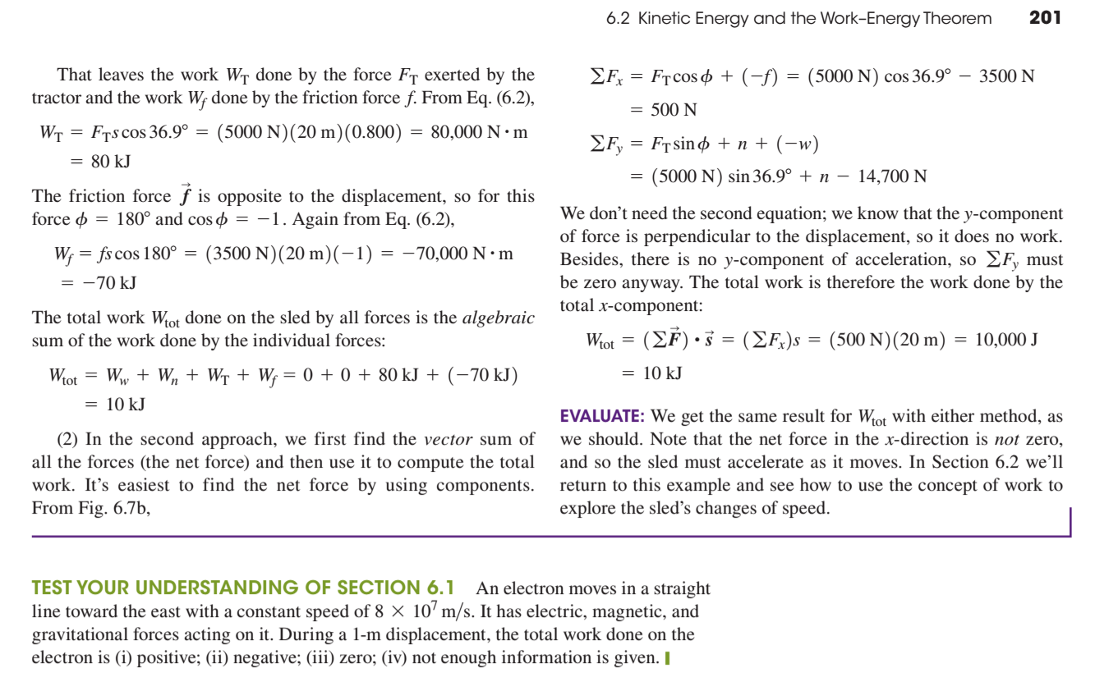

Slide 14
If the force is not constant, the infinitesimal work done is

Slide 15
Example 4
A force acts on a particle moving along the curve from x = 1 to x = 4. Calculate the work done by the force.

Slide 16
Energy
Energy is defined as the ability to do work.
Hence, energy and work are equivalent.
There are different types of energy such as light, heat, sound, electrical, thermal and mechanical.
Mechanical energy are kinetic energy and potential energy.
The SI unit of energy is the same as work which is the joule (J).

Slide 17
Principle of conservation of energy
The principle of conservation of energy states that energy :
can neither be created nor destroyed in any process.
can be converted from one type to another (including work).
can be transferred from one body to another with the total amount remaining constant.
The total energy of an isolated system (one that is not interacting with other systems) is constant.

Slide 18
Potential energy
Potential energy is defined as the energy stored in an object by the virtue of its position or state.
Examples of potential energy include :
gravitational potential energy
chemical potential energy
elastic potential energy
electric potential energy

Slide 19
Gravitational potential energy (GPE)
Suppose a force F lifts a mass m vertically up at constant velocity from y₁ = 0 to y₂.
The work done by F on the mass is
Since the mass moved at constant velocity, there is no change in its KE and the work done by F has increased the GPE of the object by mgh.
F
y₂
y₁

Slide 20
Gravitational potential energy (GPE)
If we use the force of gravity, the work done on the mass is negative because the weight W is in the opposite direction.
In other words, the work done by gravity is the negative of the increased the GPE of the object.
F
y₂
y₁

Slide 21
Conservation of mechanical energy
From the work energy theorem, W_{grav} = K₂ – K₁.
Since W_{grav} = – ΔU_{grav}
The quantity K + U is the total mechanical energy of the system.
If the mass is released, the GPE is converted to KE of the mass as it falls.
At any height, K + U is constant.

Slide 22
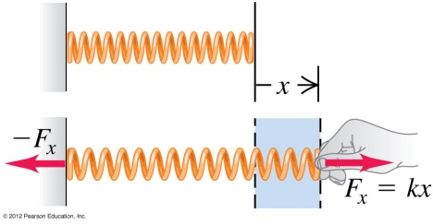
Elastic potential energy
Hooke’s law states that the force to stretch a spring is directly proportional to the elongation x of the spring, i.e.
F_{x} = kx where k is the spring constant.
The work done by the applied force F_{x} to stretch the spring from x = x₁ to x = x₁ is
The term is the elastic potential energy (U_{el}) of the spring.

Slide 23
Elastic potential energy
If we use the tension in the spring to calculate the work done in stretching the spring, we will get a negative answer because the direction of the tension on the mass is opposite to its displacement.
Since the change in elastic potential energy is positive, we have

Slide 24
Conservative system and forces
Systems where the total mechanical energy is conserved are known as conservative systems.
The forces which act in a conservative system are known as conservative forces.
Examples of conservative forces are gravity and tension in a spring.

Slide 25
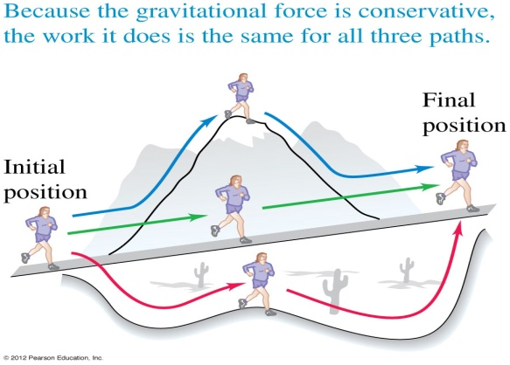
Work done by a conservative force
The work done by a conservative force can be expressed as the difference between the initial and final values of a potential energy function.
It is independent of the path taken by the object.
When the start and the end points are the same, the total work done by the conservative force is zero.

Slide 26
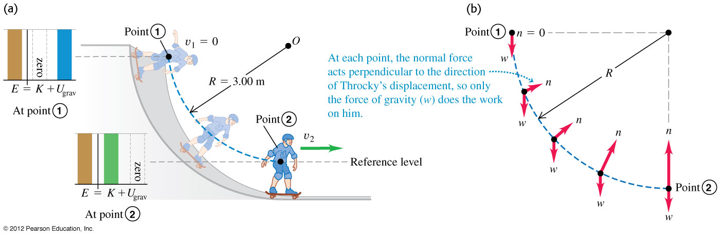
Example 5
A man skateboards from rest down a curved, frictionless ramp. If we treat the man and his skateboard as a particle, he moves through a quarter circle with radius R = 3.00 m (see figure). The mass of the person and the skate board is 25.0 kg. (a) Find his speed at the bottom of the ramp and (b) Find the normal force that acts on him at the bottom of the curve.

Slide 27
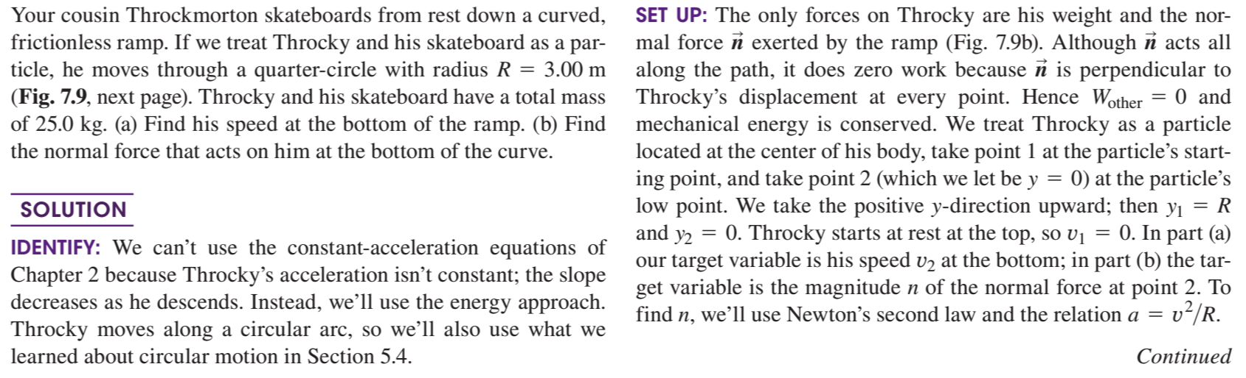

Slide 28
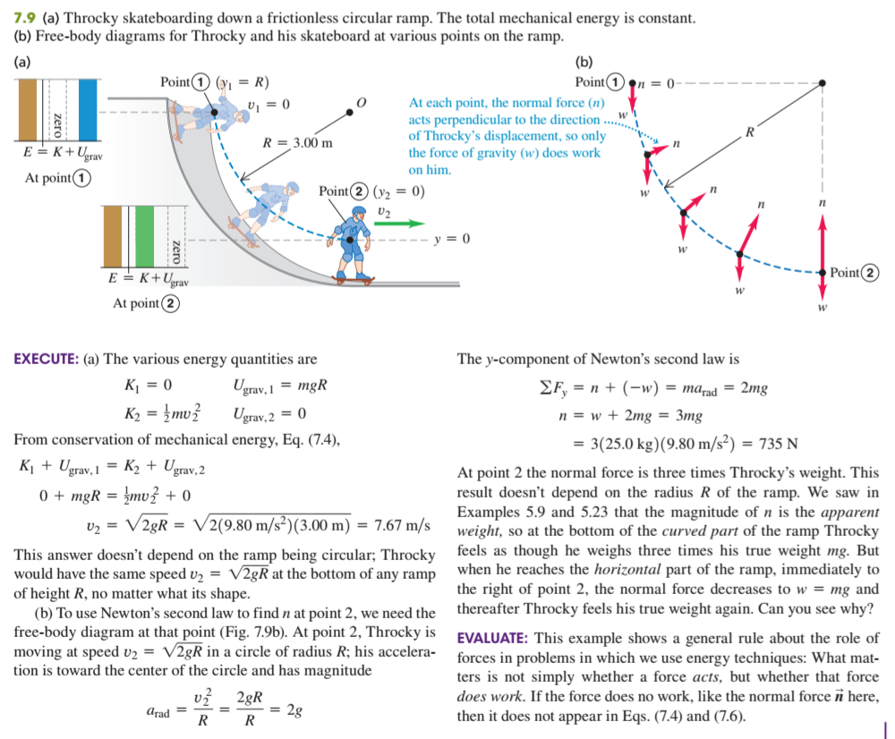

Slide 29
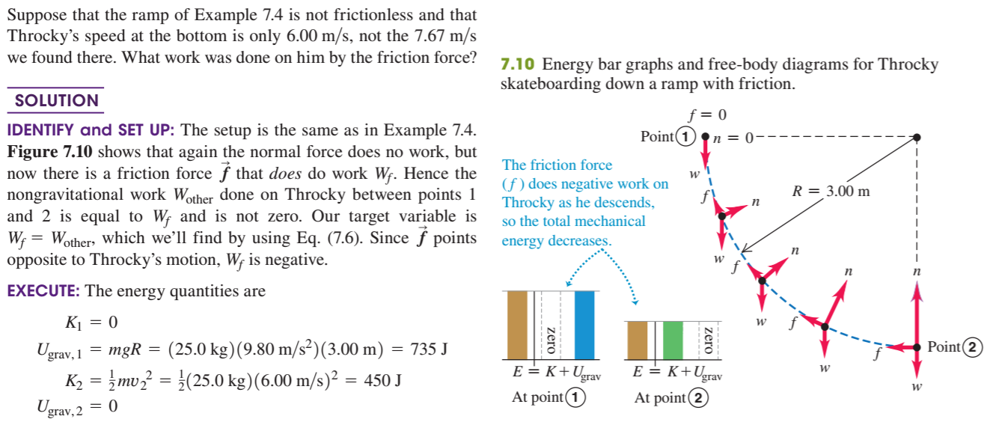

Slide 30
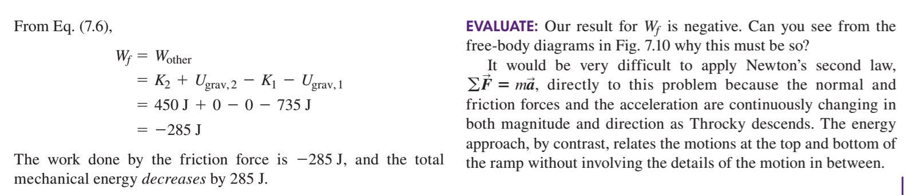

Slide 31
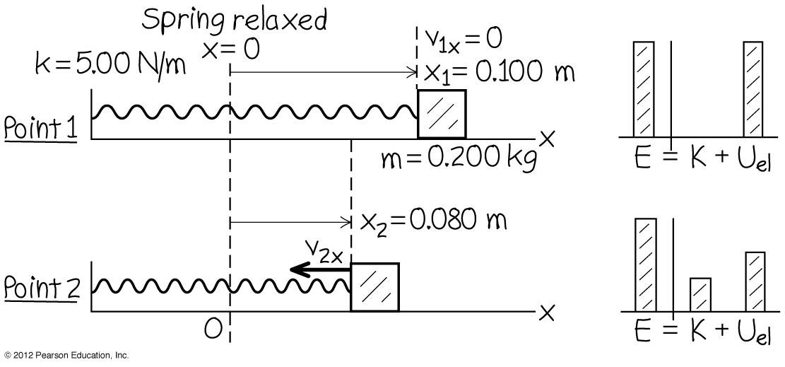
Example 6
A mass of 0.200 kg sits on a frictionless horizontal surface connected to a spring with force constant 5.00 N/m. The mass is pulled so that it stretches the spring 0.100 m and then released from rest. The mass moves back toward it equilibrium position. What is its x-velocity when x = 0.080 m?

Slide 32
Conservative force and potential energy
The work done by a conservative force is related to the change in potential energy of the system by W = –∆U.
If ∆x is the displacement of a particle, and if F_{x} is constant, we can write
Hence we can calculate the conservative force if we know the potential energy function.

Slide 33
Conservative force and potential energy
The conservative force always acts to reduce the system’s potential energy.
If the potential energy function is known we will be able to find the conservative force.
For example the potential energy stored in a spring is U = ½ kx² .
The conservative force in the spring the mass is
F = -dU/dx = -kx, which is the same as that given by Hooke’s law.

Slide 34
Non-conservative force
A force that is not conservative is called a non-conservative force.
Examples are friction and the force unleashed in exploding fire crackers.
The work done by a non-conservative force cannot be represented in terms of a potential energy function.
If we toss an object onto a rough horizontal surface, it will come to rest because of work done by friction, which is converted to thermal energy of the object and the surface. i.e. ∆U_{int} = – W_{non-conservative forces}
W_{non-conservative forces} is negative because friction acts opposite to the displacement of the object. Hence ∆U_{int} is positive.

Slide 35
Non-conservative force
If we include the loss of the initial total mechanical energy due to conservative forces, we can write the law of conservation of energy as
K₁ + U₁ – ∆U_{int} = K₂ + U₂
or ∆K + ∆U + ∆U_{int} = 0

Slide 36
Power
We often need to know how quickly the work was done.
Therefore we define a quantity power which is the rate at which work is done.
When ∆W amount of work is done during a time interval ∆t, the average work done per unit time or the average power is
The instantaneous power s
The SI unit of power is joule per second or watt (W).
The kilowatt (kW) and megawatt (MW) are commonly used in electricity.

Slide 37
Power in terms of force and velocity
Suppose a force acts on a body while it undergoes a displacement .
The infinitesimal work done
The instantaneous rate of work done is
Hence

Slide 38
Example 7
A 50.0-kg marathon runner runs up the stairs to the top of Chicago’s Willis tower whose height is 443 m. To lift herself to the top in 15.0 minutes, what must be her average power output?

Slide 39
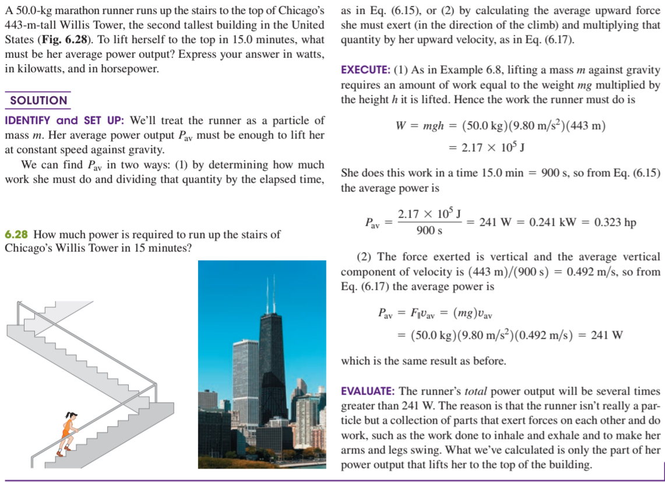

Slide 40
Domestic unit of power
The domestic unit of electricity is the kilowatt-hour (kWh).
One kWh is the energy used by a device at a rate of 1000 watts in one hour.
1 kWh = 1000 W × 3600 s = 3.6 × 10⁶ J = 3.6 MJ.
The cost of electricity is based on the number of kilowatt-hour (kWh) of electrical energy used.

Slide 41
Efficiency of machines
By the principle of conversation of energy, energy input equals useful energy output plus wasted energy due to friction and other work.

Slide 42
Useless work
The useful work is the work done in raising the load.
In the double pulley system shown below, the lower pulley and rope have weight and work must be done to raise them in order to lift the load.
The work done to raise the lower pulley and rope are useless work.
Load

Slide 43
End of chapter

